Slide 1


SMART INDIA HACKATHON 2026
TITLE PAGE
Problem Statement ID – SIH26026
Problem Statement Title - AI-Enabled Quadruped & Handheld System for Real-Time Narcotics & Explosives Detection in Indian Railways
Theme - Blockchain & Cybersecurity
PS Category- Hardware
Team ID-
Team Name (Registered on portal) - Cyber Renegades

Slide 2
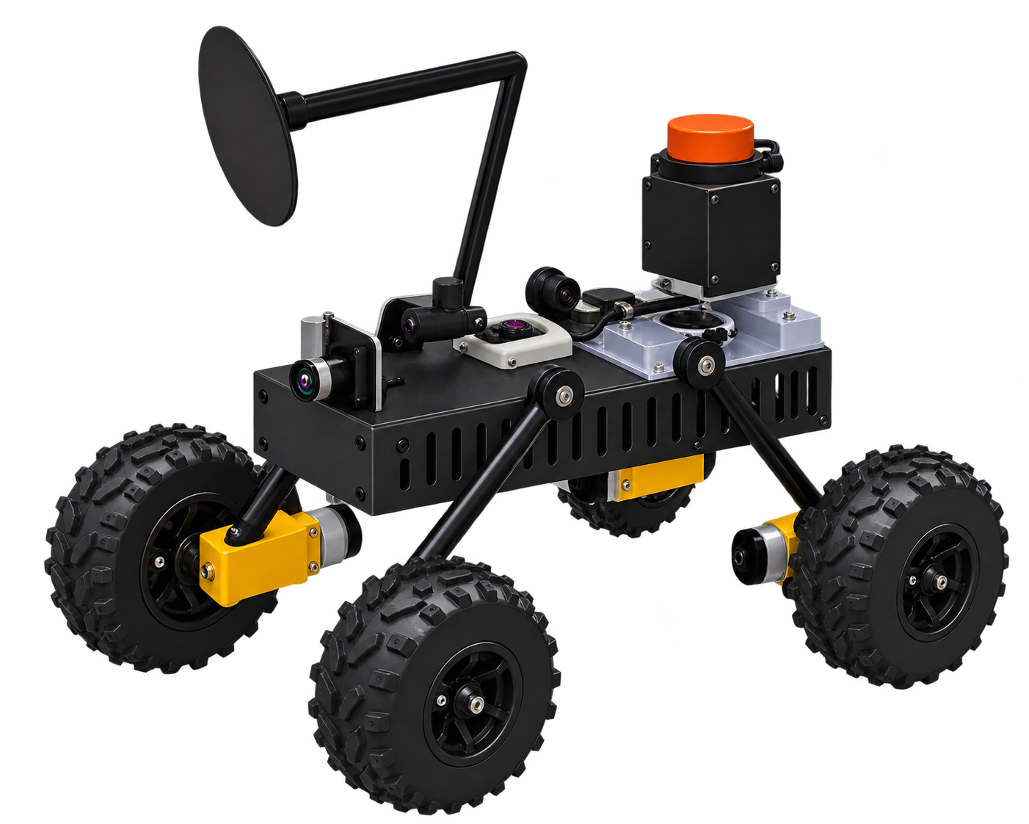
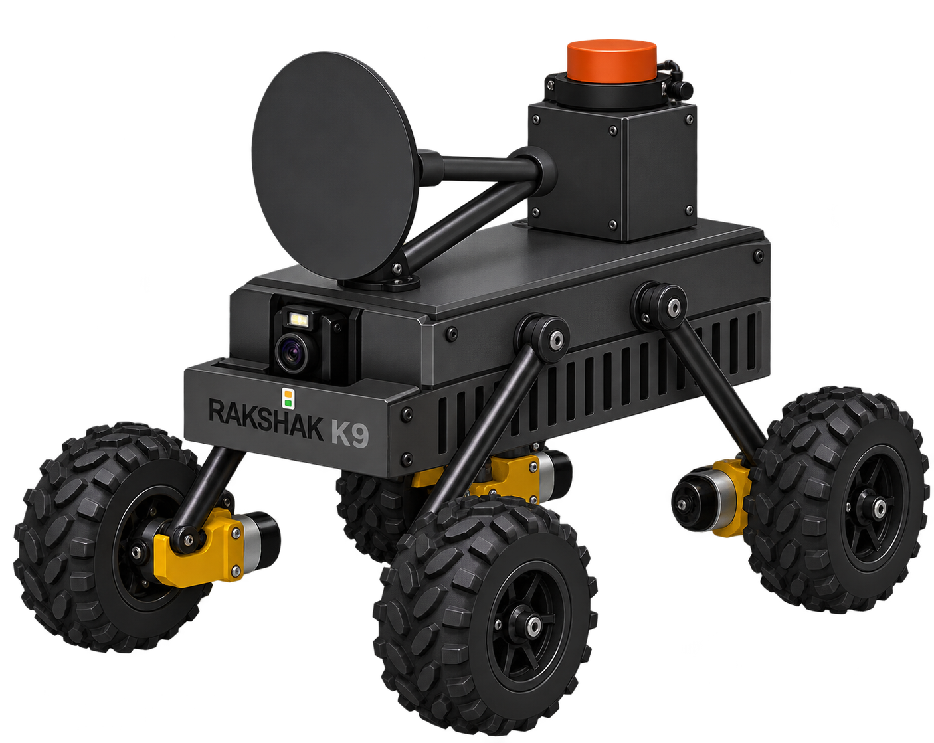
RAKSHAK-K9:AI-Powered Quadruped & Handheld System for Real-Time Narcotics and Explosives Detection
Cyber Renegades
PROBLEM EXISTING
OUR IDEA
No Field Detection Tech: RPF secures 1000s of stations but has zero mobile system for real-time narcotics/explosives screening.
Manual Checks Don't Scale: ₹300 Cr seized in 2025 alone — yet what's caught is a fraction of what moves through.
Evidence Doesn't Hold Up: No verifiable chain of custody means a catch can be challenged in court.
Rakshak K9 is an AI quadruped robot that patrols railways, detecting narcotics and explosives via vision, gas, metal, and radar sensors. On a hit, it alerts RPF and offers a detachable handheld unit for close inspection. Every detection is stored via IPFS and blockchain — tamper-evident, yet always recoverable.
PROPOSED SOLUTION
UNIQUE VALUE PREPOSITION
Autonomous Patrol Robot: Quadruped navigates platforms, coaches & tracks via LiDAR-SLAM, scanning 360° for anomalies.
Smart Sensor Activation: Camera classifies first, then fires only the right sensor — BME688, PI metal detector, or mmWave 3D scan.
Human-in-the-Loop: Holds safe distance, alerts officer instantly, inspects via arm — autonomous or remotely controlled .
Detachable Handheld Unit: Same detection core unclips for close-range, offline investigation in coaches & crowded zones.
Blockchain-Backed Evidence: Every hit is packaged with GPS + timestamp, stored on IPFS, hash-anchored on blockchain — instant, court-ready proof.
Detection + Legal Proof, One System: Most systems stop at an alarm. We carry it through to a blockchain-verified record.
Tamper-Evident & Recoverable: Tampering breaks the IPFS hash instantly, but the original file stays retrievable — nothing is ever truly lost.
Works With No Network: Offline logging and sync-on-reconnect keep detection running even in dead zones.
Detachable Arm for Manual Inspection: The same detection unit unclips so an RPF officer can investigate up close, on foot, wherever the robot can't reach.
One Robot, Every Terrain: A single unit patrols platforms, coaches, and tracks — no separate machines needed for each environment.
2
@SIH Idea submission- Template

Slide 3
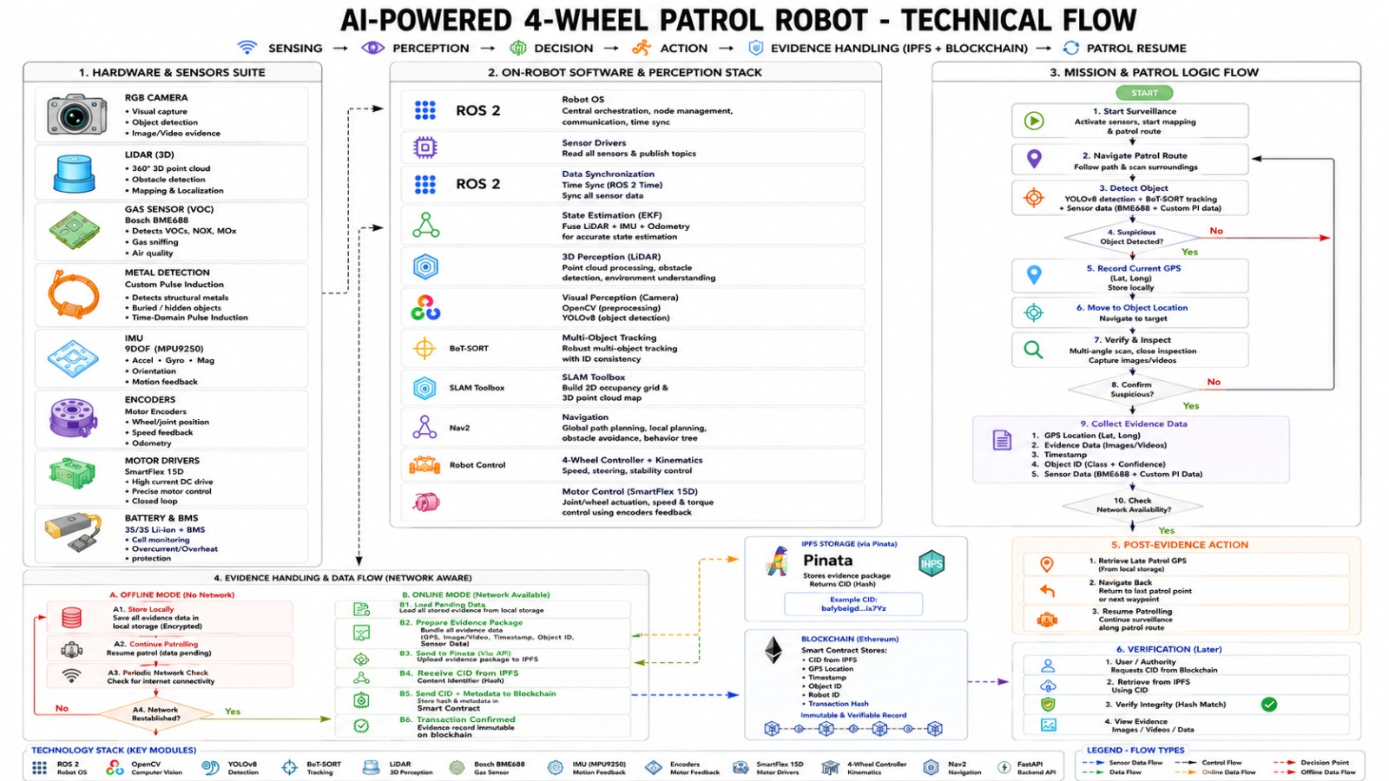
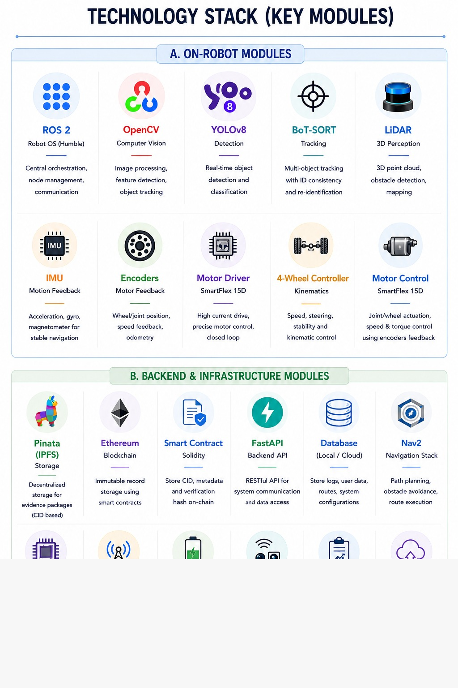
TECHNICAL APPROACH
Cyber Renegades

Slide 4
FEASIBILITY AND VIABILITY
Cyber Renegades
Technical Feasibility
Risks
Strategies to Solve the risks
1. ROS 2 + Quadruped Mobility
Mature ROS 2/Nav2 ecosystem, better suited for railway terrain, and feasible for prototype development.
2. Camera-Gated Sensor Activation
Camera-based AI activates sensors only when needed, reducing false alarms, power use, and operator fatigue.
3. Layered Detection Architecture
BME688 + Pi + camera provide low-cost screening, while advanced confirmation can be centralized at key locations.
4. Human-in-the-Loop Arm Control
Live-video teleoperation provides safer and more practical control for suspected-IED handling.
5. Offline-First Evidence Logging
Stores evidence locally, hashes it for integrity, and syncs when connectivity returns—reliable and cost-effective.
1. BME688 overclaiming narcotics/explosives identification
→ Reframe as anomaly-screening, paired with confirmatory detection.
2. Legged robot mechanical failure on railway ballast/uneven terrain
→ Early terrain testing + fallback "safe mode" on stumble/tip detection.
3. Detachable arm connector reliability (dust, vibration)
→ Simplify to latch + tethered cable for prototype instead of full autonomous docking.
4. Connectivity gaps breaking real-time evidence sync
→ Offline-first design: SD card log → hash → sync on reconnect.
5. : Payload/Power Budget Exceeded
The combined weight and power demand of sensors, cameras, Jetson, arm, and battery may reduce mobility and runtime.
1. BME688 Detection Limitations
→ Use BME688 only for VOC anomaly screening, followed by secondary sensing or operator verification.
2. Mechanical Failure on Uneven Terrain
→ Perform extensive terrain testing and add stumble/tip detection to stop the robot and alert the operator.
3. Detachable Arm Reliability
→ Use a simple latch with tethered cables initially; upgrade to rugged connectors after testing.
4. Connectivity Gaps
→ Log data locally, hash it, and sync to the blockchain/dashboard when connectivity returns, preventing evidence loss.
5. Payload/Power Budget
→ Perform an early mass and power budget, use camera-gated sensors, and deploy swappable batteries to extend runtime.

Slide 5
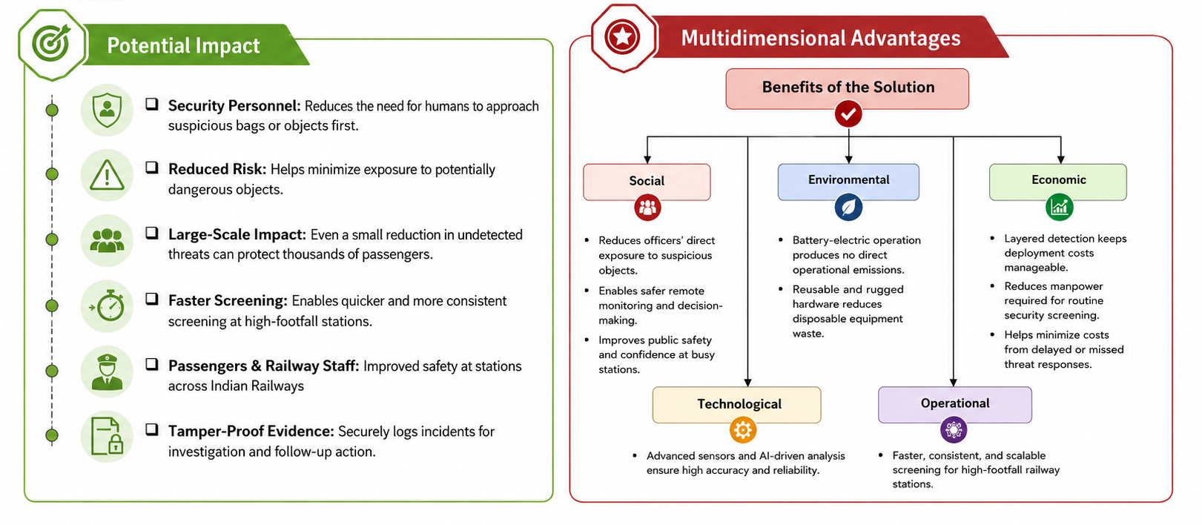
IMPACT AND BENEFITS
Cyber Renegades
Potential Impact
Security Personnel: Reduces the need for humans to approach suspicious bags or objects first.
Multidimensional Advantages
Reduced Risk: Helps minimize exposure to potentially dangerous objects.
Social
Reduces officers’ direct exposure to suspicious objects.
Enables safer remote monitoring and decision-making.
Improves public safety and confidence at busy stations.
Large-Scale Impact: Even a small reduction in undetected threats can protect thousands of passengers.
Environmental
Battery-electric operation produces no direct operational emissions.
Reusable and rugged hardware reduces disposable equipment waste.
Faster Screening: Enables quicker and more consistent screening at high-footfall stations.
Passengers & Railway Staff: Improved safety at stations across Indian Railways
Economic
Layered detection keeps deployment costs manageable.
Reduces manpower required for routine security screening.
Helps minimize costs from delayed or missed threat responses.
Tamper-Proof Evidence: Securely logs incidents for investigation and follow-up action.

Slide 6
RESEARCH AND REFERENCES
Cyber renegades
Datasets
Indian Railway Dataset – Project Rail (Roboflow Universe)
https://universe.roboflow.com/project-rail/indian-railway
Railway Station Platform Dataset – BE Project (Roboflow Universe)
https://universe.roboflow.com/be-project-x2dra/railway-station-platform-qozzz
Compute & Navigation
NVIDIA Jetson Nano – Embedded Developer Kit (NVIDIA)
https://developer.nvidia.com/embedded/jetson-nano-developer-kit
ESP32-WROOM-32D Datasheet (Espressif Systems)
https://www.espressif.com/en/products/socs/esp32
Sensors
RPLiDAR A1 (A1M8) Specifications (SLAMTEC)
https://www.slamtec.com/en/lidar/a1spec
BME688 Gas Sensor & BSEC AI-Studio (Bosch Sensortec)
https://www.bosch-sensortec.com/products/environmental-sensors/gas-sensors/bme688/
Drivetrain & Power
SmartElex 15D Dual DC Motor Driver (Robu.in)
https://robu.in/product/smartelex-15d-dual-channel-dc-motor-driver/
Lithium-ion Battery Architecture Guide (Battery University)
https://batteryuniversity.com/article/bu-205-types-of-lithium-ion
Blockchain, IPFS & Edge AI Research
IPFS Official Documentation
https://ipfs.tech/
Hyperledger Fabric (Hyperledger Foundation)
https://www.hyperledger.org/projects/fabric
AI Tools
Claude (Anthropic) – AI Assistant used for research and system design
https://claude.ai

